Slide 1

Boolean

Slide 2
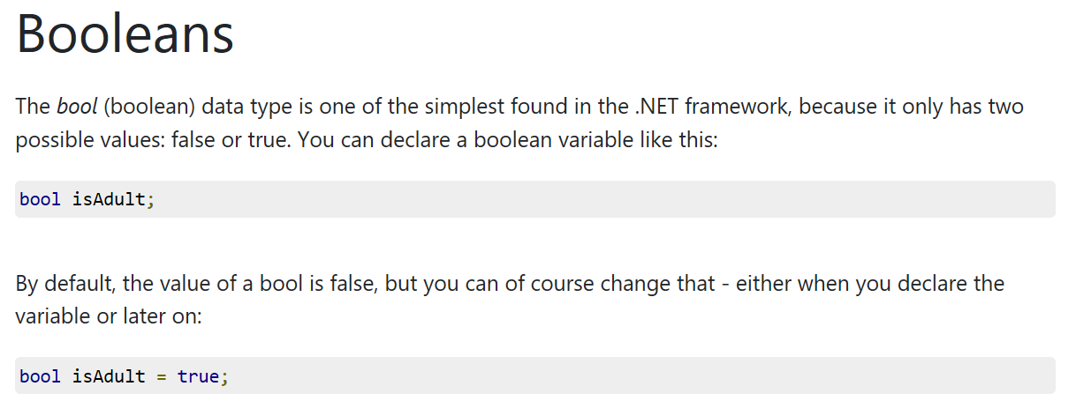

Slide 3
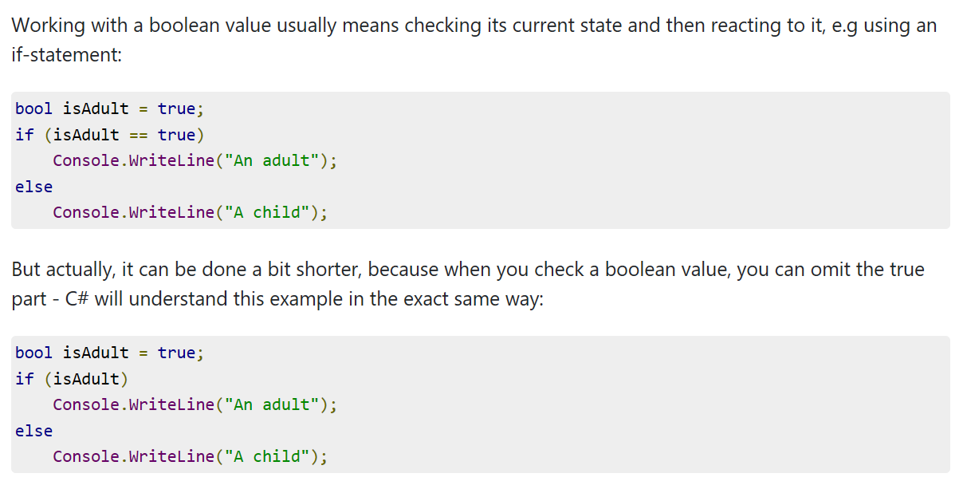

Slide 4
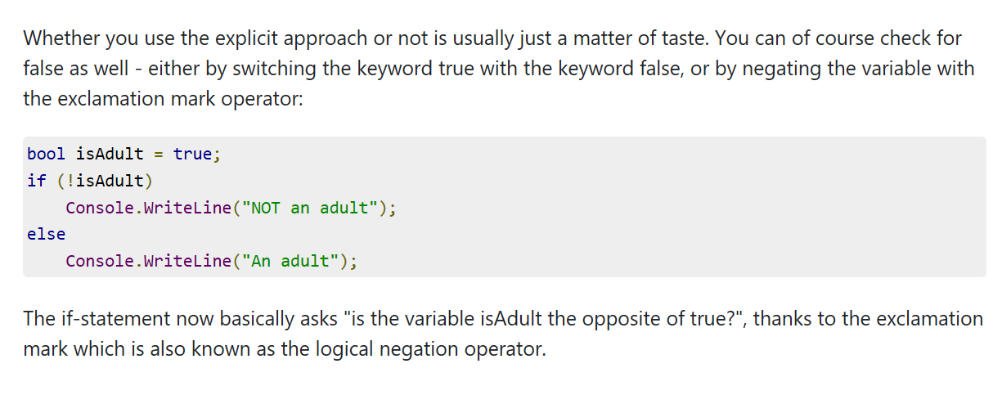

Slide 5
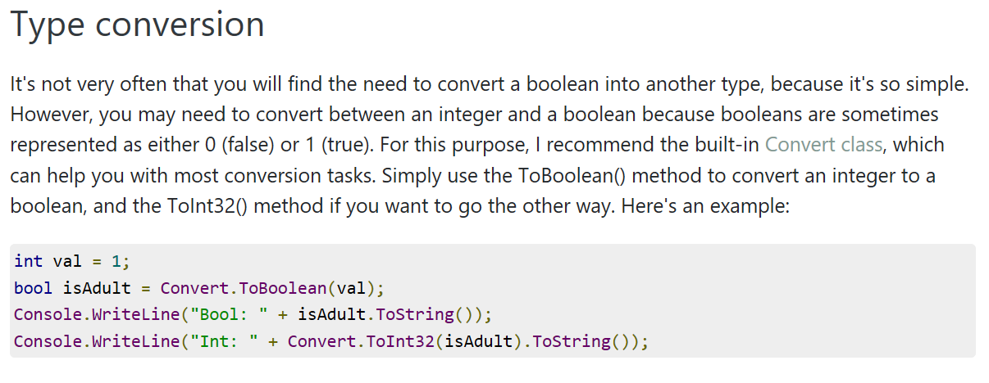

Slide 6
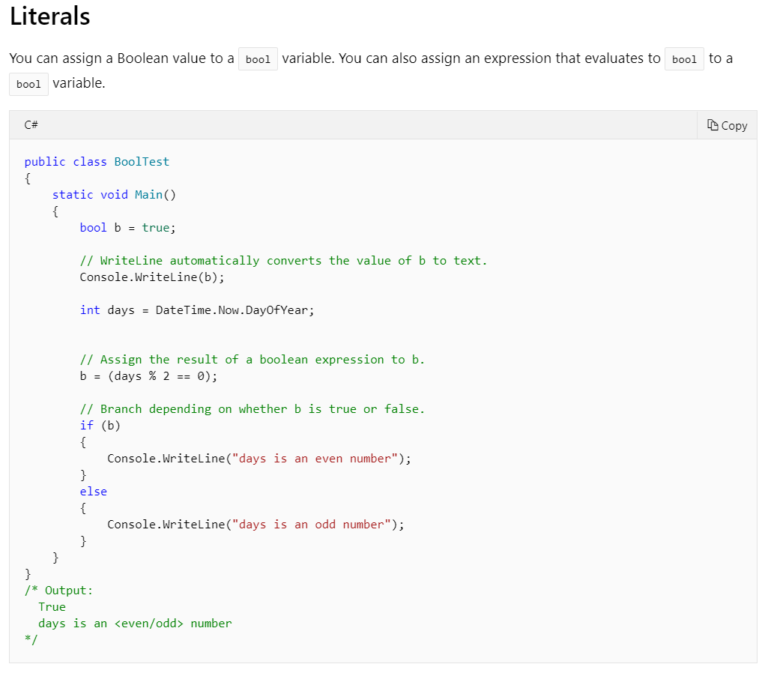

Slide 7

Summary
The bool data type can only have two values - false or true. It's easy to check with an if statement and is often the return type of many methods.

Slide 8
Quick Exercise
Create a program such that when you enter a character from the keyboard, the program checks if the input character is a letter. If it is a letter, it checks if it is lowercase or uppercase.

